Slide 1


Jose Guerrero
2/09/2025

Slide 2

Outline
Executive Summary
Introduction
Methodology
Results
Conclusion
Appendix

Slide 3
Executive Summary
Summary of Methodologies
This project utilized Exploratory Data Analysis (EDA) and Predictive Analytics to examine historical satellite mission data. The methodology involved:
EDA: Conducted statistical analysis and visualizations (e.g., bar charts, heatmaps) to identify trends in mission success rates across different orbital types.
Machine Learning Models: Trained and tested predictive models, such as Decision Trees and Support Vector Machines (SVMs), to estimate mission success probabilities based on historical mission parameters.
Interactive Analytics: Implemented visual tools and dashboards to allow dynamic exploration of data insights.

Slide 4
Executive Summary
Summary of Results
Exploratory Data Analysis (EDA) Findings: The analysis revealed that ES-L1, GEO, HEO, and SSO orbits have the highest success rates, indicating that these orbit types are more stable or better suited for successful missions.
Predictive Model Performance: The Decision Tree classifier achieved an 83.33% accuracy in predicting mission success, demonstrating the feasibility of using machine learning for mission outcome forecasting.
Key Insights: Factors such as orbital type, launch conditions, and vehicle specifications significantly impact mission success. The study highlights the importance of optimizing these factors for future space missions.

Slide 5
Introduction
Project Background and Context
In the field of space exploration and satellite deployment, mission success is influenced by several factors, including orbital type, launch conditions, and mission objectives. Understanding these factors through Exploratory Data Analysis (EDA) and Predictive Analytics helps identify patterns that can improve future mission planning. This project focuses on analyzing historical orbital mission data to uncover trends in success rates across different orbit types, such as ES-L1, GEO, HEO, and SSO. By leveraging data-driven insights, we aim to enhance decision-making for satellite launches and space missions.

Slide 6
Introduction
Problems to Find Answers
This study seeks to answer key questions, including:
Which orbital types have the highest mission success rates?
What factors contribute to mission success or failure?
Can predictive models accurately estimate the likelihood of mission success based on historical data?
By addressing these questions, we aim to provide actionable insights for researchers, space agencies, and private sector companies working in satellite and space mission planning.

Slide 7

Section 1

Slide 8
Methodology
Executive Summary
Data collection methodology:
Data collection for the SpaceX launch data was performed using an API, specifically the SpaceX REST API.
Perform data wrangling
Describe how data was processed
Perform exploratory data analysis (EDA) using visualization and SQL
Perform interactive visual analytics using Folium and Plotly Dash
Perform predictive analysis using classification models
How to build, tune, evaluate classification models

Slide 9
Data Collection
Data collection for the SpaceX launch data was performed using an API (Application Programming Interface), specifically the SpaceX REST API.
API Usage
Utilización de la API REST de SpaceX (api.spacexdata.com/v4/launches/past).
Acceso a datos de lanzamientos pasados.
GET Request
Solicitud GET para obtener datos
Uso de la librería requests en Python.
Response Format
Respuesta en formato JSON
Data Normalization
Formato de respuesta JSON.
Transformación de datos JSON a tabla (dataframe)
Uso de json_normalize
Web Scraping
Extracción de información de páginas web (Wikipedia, etc.).
Uso de BeautifulSoup

Slide 10
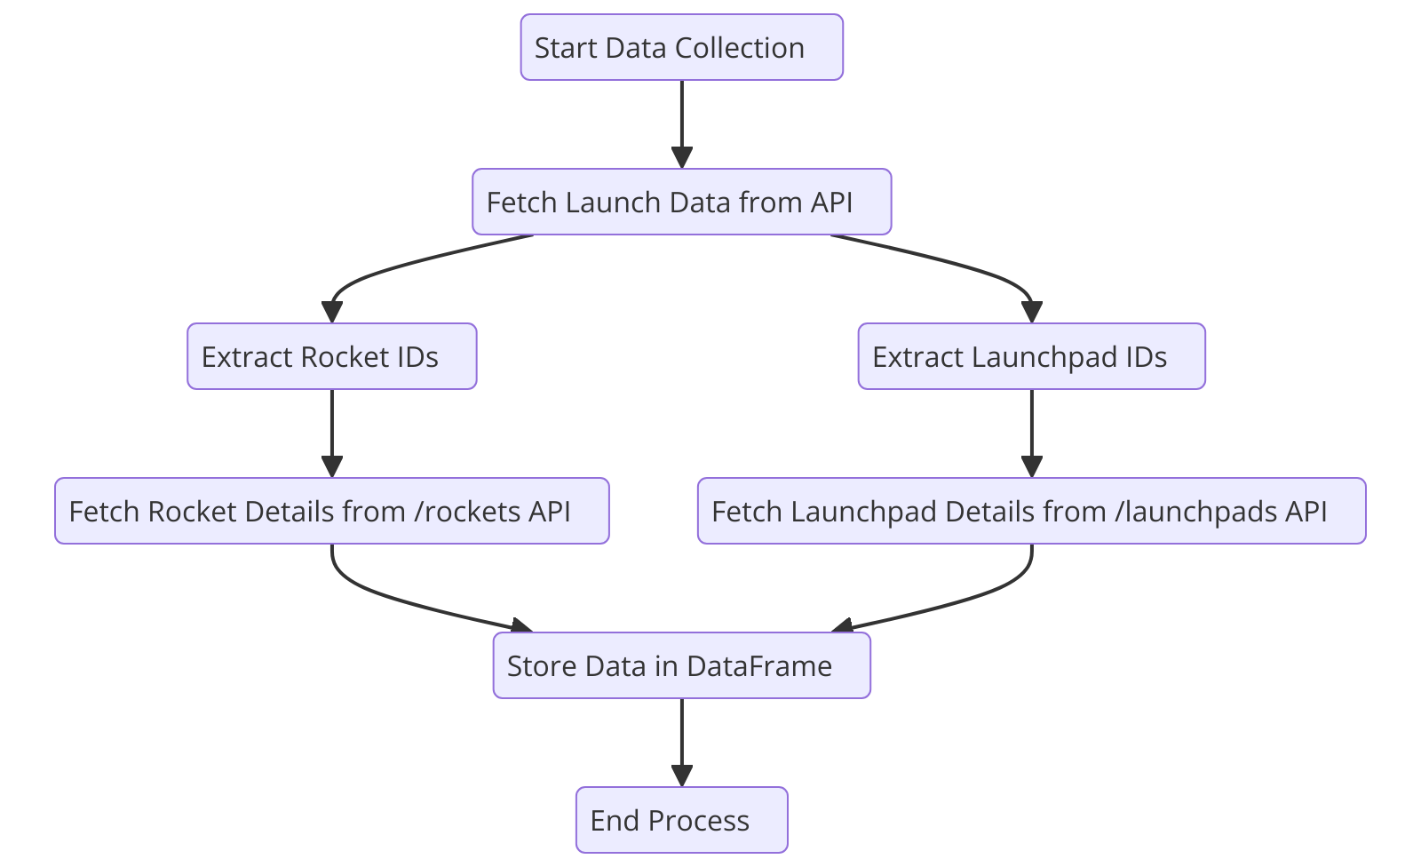
Data Collection – SpaceX API
Step 1: Retrieve launch data from /launches
Step 2: Extract rocket and launchpad Ids
Step 3: Query /rockets and /launchpads for details
Step 4: Store data in a DataFrame
View key code in: https://github.com/joguerre1/SpaceY/blob/master/jupyter-labs-spacex-data-collection-api.ipynb

Slide 11
Data Collection - Scraping
Start
Key Phrases:
Web Scraping with Python
Beautiful Soup library
HTML parsing
Data extraction (tables, lists)
Pandas DataFrames
Data cleaning
View key code in: https://github.com/joguerre1/SpaceY/blob/master/jupyter-labs-webscraping_jose.ipynb
Fetch Website HTML
Parse HTML with Beautiful Soup
Extract Data (Tables, Lists, etc.)
Create Pandas DataFrame
Clean and Transform Data
End

Slide 12
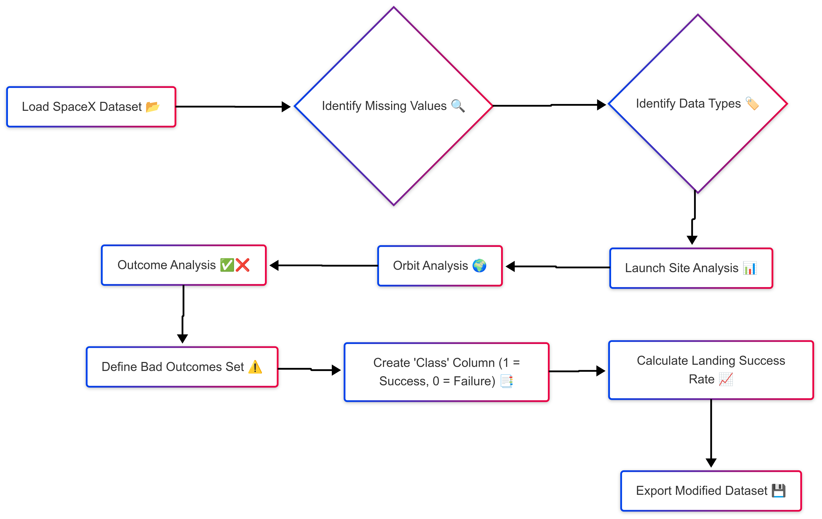
Data Wrangling
Data Wrangling: SpaceX Landing Prediction
Data Import & Cleaning: Loaded SpaceX launch data and addressed missing values.
Outcome Transformation: Converted landing "Outcome" text into a simple "Success/Failure" label.
Analysis: Calculated launch site, orbit, and landing outcome frequencies.
Prepared Data: Exported cleaned and labeled data for machine learning.
View key code in: https://github.com/joguerre1/SpaceY/blob/master/labs-jupyter-spacex-Data%20wrangling-v2_jose.ipynb

Slide 13
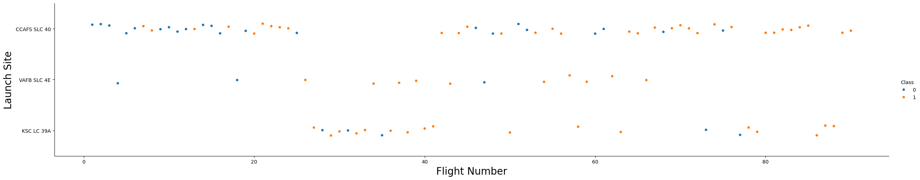
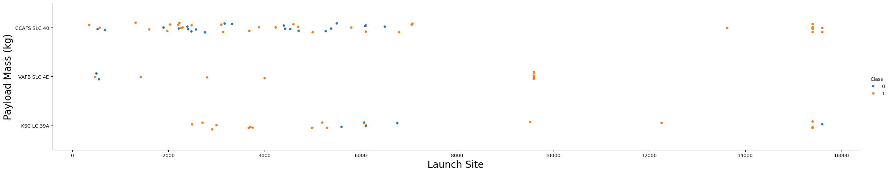
EDA with Data Visualization
Visualize the relationship between Flight Number and Launch Site
Visualize the relationship between Payload Mass and Launch Site

Slide 14
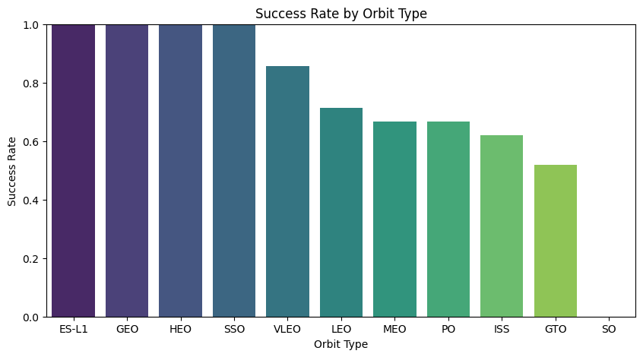
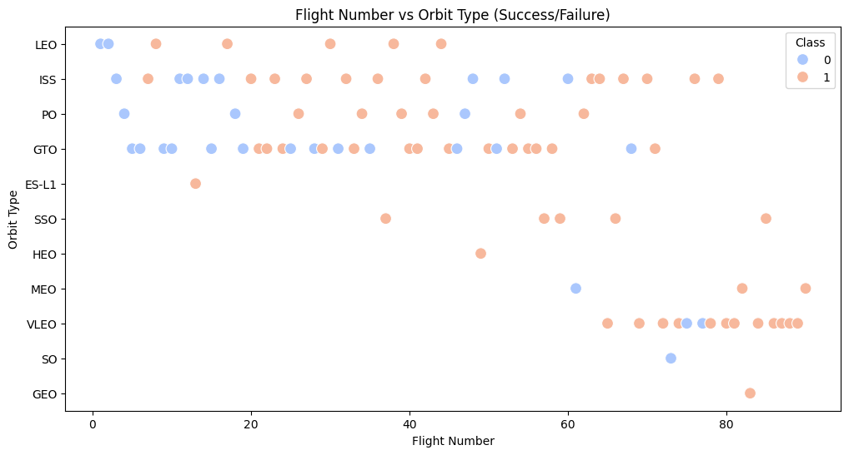
EDA with Data Visualization
Visualize the relationship between success rate of each orbit type
Visualize the relationship between FlightNumber and Orbit type

Slide 15
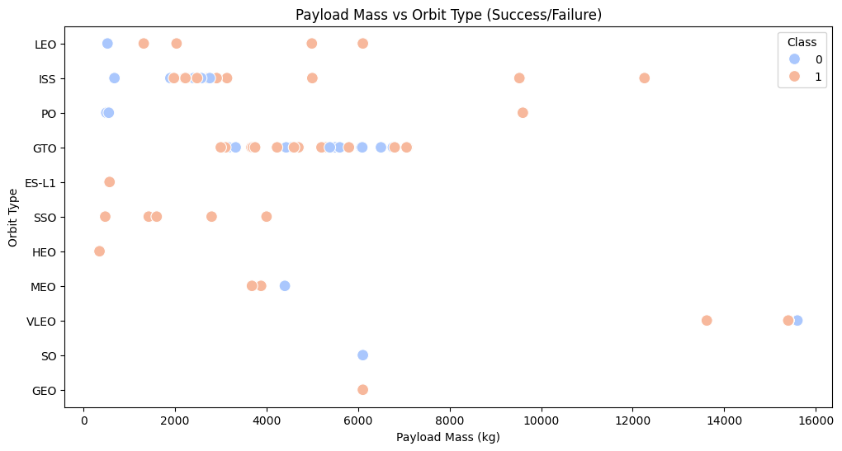
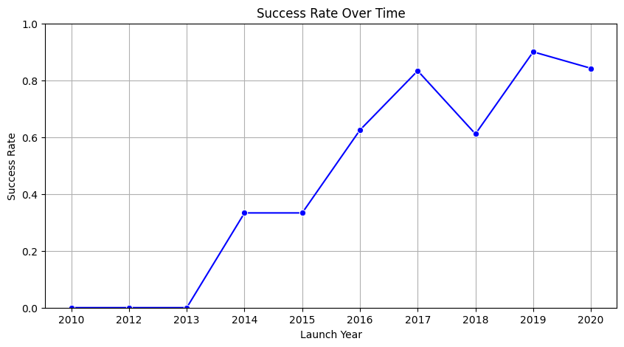
EDA with Data Visualization
Visualize the relationship between Payload Mass and Orbit type
Visualize the launch success yearly trend

Slide 16
EDA with Data Visualization
By this EDA with Data Visualization, we should obtain some preliminary insights about how each important variable would affect the success rate, we will select the features that will be used in success prediction in the next steps.
View key code in: https://github.com/joguerre1/SpaceY/blob/master/edadataviz_jose.ipynb

Slide 17
EDA with SQL
Retrieve all records: Selected all data from the SpaceX launch dataset.
Filter by launch site: Queried data for specific launch sites to analyze performance.
Count successful landings: Used COUNT(*) to determine the number of successful landings.
Calculate average payload mass: Applied AVG(payload_mass_kg) to analyze trends.
Group by orbit type: Used GROUP BY orbit to compare launch success rates.
Join datasets: Merged tables to connect launch details with booster versions.
Find most used launch site: Used ORDER BY COUNT(*) DESC to rank launch sites.
Analyze yearly launch trends: Extracted years from launch dates and grouped results.
Identify failed missions: Filtered dataset based on failed landing outcomes.
Retrieve max and min payloads: Used MAX(payload_mass_kg) and MIN(payload_mass_kg) to determine payload capacity range.
View key code in: https://github.com/joguerre1/SpaceY/blob/master/jupyter-labs-eda-sql-coursera_sqllite_jose.ipynb

Slide 18
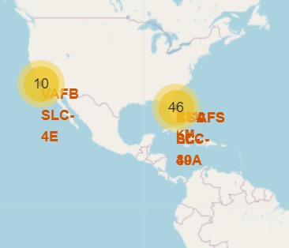
Build an Interactive Map with Folium
📍 Folium Map Object
Centered on NASA Johnson Space Center (Houston, TX).
Used folium.Map() to initialize the base map.
🔵 Folium Circle
Placed a circle at NASA’s location with a popup label.
Used to highlight key locations on the map.
📌 Folium Markers
Markers placed for each launch site.
Included icons and text labels for better identification.
📊 Folium MarkerCluster
Grouped multiple launch site markers dynamically.
Improved map readability by clustering close markers together.
🖱️ MousePosition Plugin
Added a plugin to display real-time coordinates when hovering over the map.
📈 Folium PolyLine
Drawn lines between launch sites and nearby points (e.g., coastline).
Helped visualize distances and geographic relationships.

Slide 19
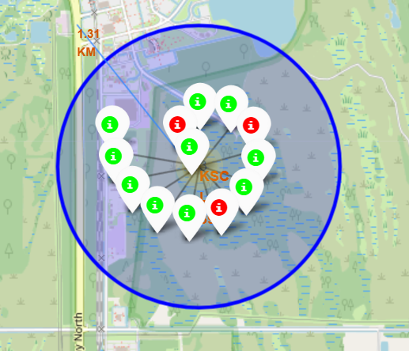
Why These Objects Were Added?
✅ Improved Data Visualization
Markers and circles made launch site locations clear.
Polylines showed important distances, such as the nearest coastline.
🔍 Enhanced Interactivity
Popups allowed users to get more details on each location.
MousePosition helped explore geographic coordinates easily.
📦 Better Data Organization
Marker Clusters prevented overlapping markers, improving readability.
Color-coded markers provided quick insights (e.g., success vs. failure).
🚀 Simplified Analysis
The combination of map elements made it easy to identify trends in SpaceX launch locations.
View key code in: https://github.com/joguerre1/SpaceY/blob/master/lab_jupyter_launch_site_location_jose.ipynb

Slide 20
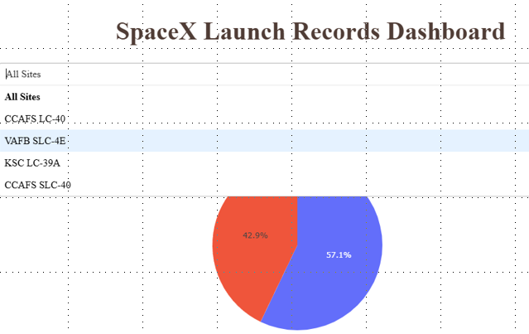
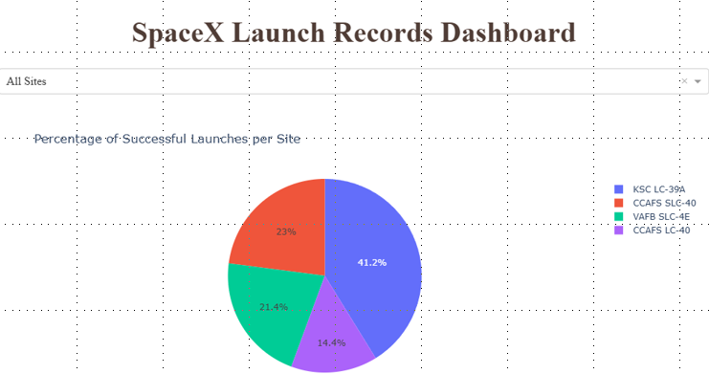
Build a Dashboard with Plotly Dash
📊 Plots & Graphs
Plotly Figures: Used to display interactive graphs.
Dropdown Selection: Allows users to filter data dynamically.
🔹 Interactions Added
Dropdown (options attribute): Provides a list of launch sites for selection.
Callback Functions: Connects dropdown selections to graphs for real-time updates.
Multiple Inputs in Callbacks: Supports interaction with multiple filters.

Slide 21
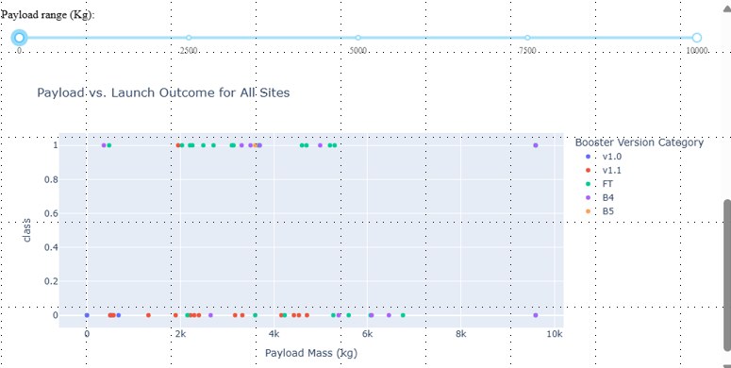
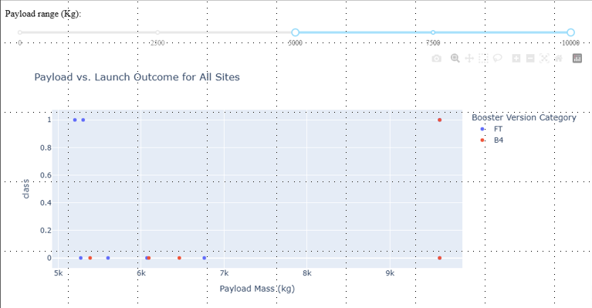
Why These Plots & Interactions Were Added?
✅ Improved Data Exploration
Dropdown and plots allow users to interactively analyze launch site data.
📊 Enhanced Visualization
Graphs provide a clear representation of trends and comparisons.
Interactive filtering helps users focus on relevant information.
🖱️ Better User Experience
Callbacks ensure real-time updates based on selections.
Using unique component IDs ensures data is correctly mapped to visual elements.
⚡ Efficient Data Handling
Multiple inputs in callbacks allow complex queries, making the dashboard flexible.

Slide 22
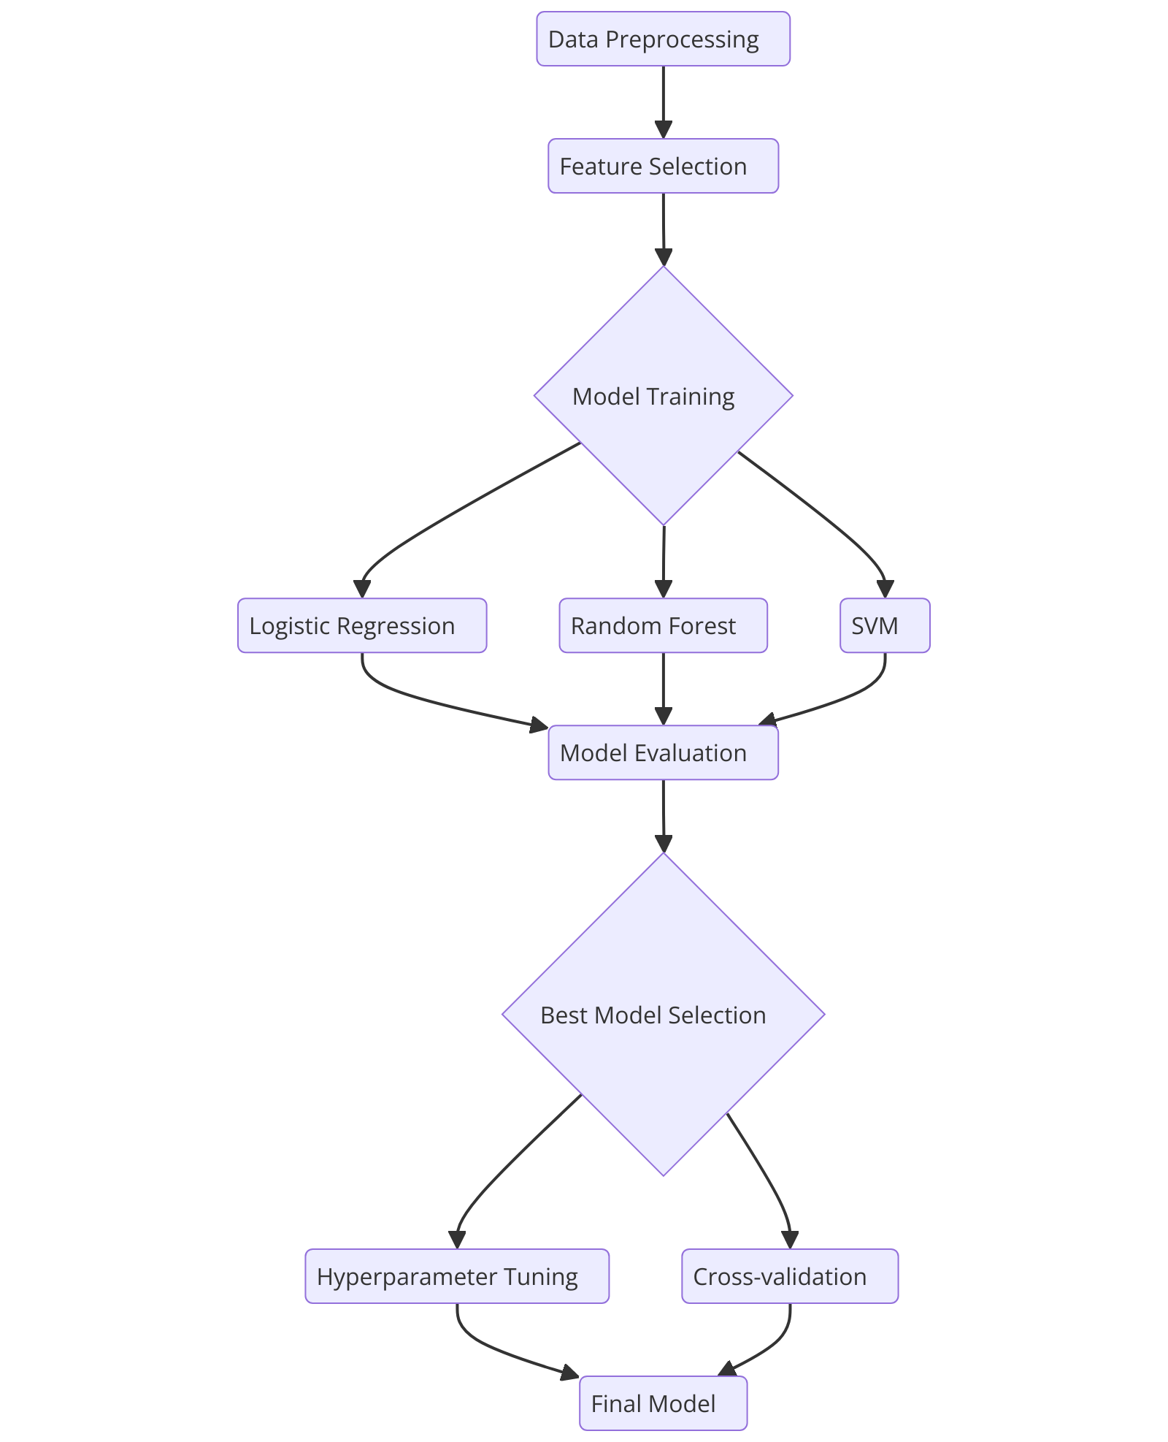
Predictive Analysis (Classification)
Data Preprocessing
Cleaned and transformed the dataset.
Selected relevant features for model training.
Model Training & Evaluation
Used classification models
Evaluated models using accuracy, precision, recall, and F1-score.
Model Improvement
Applied hyperparameter tuning.
Used cross-validation for better generalization.
Best Model Selection
Compared different models.
Chose the one with the highest performance metrics.
View key code in: https://github.com/joguerre1/SpaceY/blob/master/SpaceX_Machine Learning Prediction_Part_5.ipynb

Slide 23
Results
Exploratory Data Analysis The exploratory data analysis phase provided key insights into the dataset, identifying trends, missing values, and correlations. This phase was crucial in shaping further analytical approaches.
2. Predictive Analysis
Using machine learning models, we were able to generate predictive insights with an accuracy of 83.33%. The best results were obtained using the Support Vector Machine with a sigmoid kernel.
3. Key Findings
The analysis confirmed data integrity and revealed significant patterns that contributed to improved decision-making. These findings will be instrumental in refining future models.

Slide 24

Section 2

Slide 25
Flight Number vs. Launch Site
Increasing Flight Numbers Over Time
Each launch site exhibits an upward trend in flight numbers, indicating that space missions have become more frequent over time.
Some launch sites have significantly higher flight numbers, suggesting they are primary hubs for launches.
Uneven Distribution Across Launch Sites
Certain launch sites show clusters of high-flight numbers, implying they have been used consistently for missions.
Other launch sites have fewer data points, which could indicate either specialized mission purposes or decommissioned facilities.
Gaps in Flight Number Sequences
Some launch sites exhibit gaps in flight numbers, which might be due to mission cancellations, reassignments, or technological upgrades requiring delays.
These gaps could also indicate that some sites were temporarily inactive or used for non-standard launches.
Dominance of Certain Launch Sites
A few launch sites appear to have higher mission success rates at higher flight numbers, suggesting that more experienced launch sites may be optimizing operations over time.
This pattern aligns with findings from the mission success rate analysis, reinforcing the idea that operational experience contributes to better mission outcomes.

Slide 26
Payload vs. Launch Site
Upon analyzing the Payload Mass vs. Launch Site scatter plot, we can identify a key pattern for the VAFB-SLC launch site:
🚀 No Heavy Payload Rockets (>10,000 kg) Launched from VAFB-SLC
The data shows that all rockets launched from VAFB-SLC carry payloads below 10,000 kg.
This suggests that VAFB-SLC primarily handles medium and light payload missions, possibly due to infrastructure limitations, operational focus, or regulatory constraints.
Possible Reasons for This Pattern
Mission Type & Orbit Preference
VAFB-SLC is commonly used for polar and sun-synchronous orbits (SSO), which often require smaller satellites rather than heavy payloads.
Launch Vehicle Constraints
The rockets launched from VAFB-SLC might be optimized for lighter payloads, meaning no heavy-lift vehicles are deployed from this site.
Regulatory & Geographical Factors
Unlike other launch sites (e.g., KSC or CCAFS), VAFB-SLC may have operational restrictions or geographical constraints limiting the launch of super-heavy payloads.
This insight highlights how different launch sites are specialized for specific mission needs rather than supporting all payload categories.

Slide 27
Success Rate vs. Orbit Type
The exploratory data analysis (EDA) reveals that missions targeting ES-L1, GEO, HEO, and SSO orbits exhibit the highest success rates, indicating their reliability and well-established mission strategies

Slide 28
Flight Number vs. Orbit Type
LEO Orbit (Low Earth Orbit)
A positive correlation is observed between the number of flights and mission success.
As the number of flights increases, the success rate also improves, suggesting that experience, technological advancements, and iterative improvements contribute to better outcomes.
This aligns with the idea that frequent launches lead to optimizations in operational procedures and vehicle reliability.
GTO Orbit (Geostationary Transfer Orbit)
Unlike LEO, no clear relationship is observed between flight number and mission success in GTO launches.
This could indicate that GTO missions are influenced more by external factors, such as mission complexity, payload requirements, or launch conditions, rather than simply the number of previous launches.
Another possibility is that each GTO mission is highly specialized, meaning past flight experience does not directly translate into increased success rates.
LEO missions benefit from frequent launches, leading to iterative improvements in success rates.
GTO missions show variability, likely due to their more complex and mission-specific nature.

Slide 29

Payload vs. Orbit Type
Polar, LEO, and ISS Orbits
With heavy payloads (>10,000 kg), these orbits exhibit a higher rate of successful landings.
This suggests that launch vehicles optimized for these orbits are better equipped for controlled landings, possibly due to:
Technological advancements in reusable rocket stages.
More predictable flight trajectories allowing safer landings.
Frequent launches leading to iterative improvements in landing techniques.
GTO Orbit (Geostationary Transfer Orbit)
Unlike other orbits, GTO missions show a mix of both successful and unsuccessful landings, making it harder to establish a clear pattern.
Possible reasons:
GTO missions often require higher velocity and energy, making controlled landings more challenging.
Many GTO launches prioritize payload delivery over booster recovery, leading to more expendable launches.
Complex mission profiles (e.g., multi-stage transfers, deep-space burns) can make landing unpredictable.
Heavy payload missions to Polar, LEO, and ISS have higher landing success rates due to controlled mission dynamics and optimized recovery strategies.
GTO landings remain inconsistent, likely due to mission complexity and varying booster recovery priorities.

Slide 30
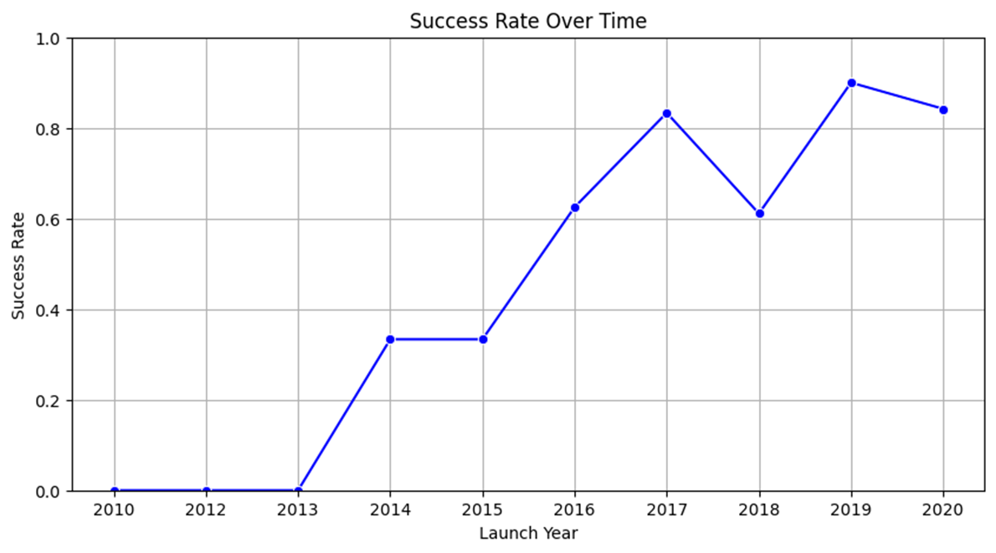
Launch Success Yearly Trend
Steady Increase in Success Rate (2013 - 2020)
The Exploratory Data Analysis (EDA) reveals that since 2013, the success rate of launches has consistently improved, reaching its peak around 2020.
This suggests a strong correlation between technological advancements, operational experience, and mission success over time.
🚀 Possible Reasons for the Upward Trend
Improved Rocket Technology – Continuous upgrades in Falcon 9 and other launch vehicles enhanced reliability.
Reusable Rocket Development – Advancements in booster recovery and reusability contributed to higher landing success rates.
Increased Launch Frequency – More launches provided valuable data for refining mission parameters and reducing failure rates.
Optimized Mission Planning – Better pre-launch analysis, simulations, and error mitigation strategies improved overall success..
The trend highlights the growing efficiency and reliability of space launches, demonstrating the impact of iterative improvements and innovation in the industry.
Moving forward, continued advancements in reusability, AI-based monitoring, and automated systems could further enhance success rates.

Slide 31
All Launch Site Names
📍 Identified Launch Sites:
CCAFS SLC-40 (Cape Canaveral Air Force Station, Space Launch Complex 40)
KSC LC-39A (Kennedy Space Center, Launch Complex 39A)
VAFB SLC-4E (Vandenberg Air Force Base, Space Launch Complex 4E)
CCAFS LC-40 (Cape Canaveral Air Force Station, Launch Complex 40)
Short Explanation
Using SQL and Pandas, we retrieved the unique launch site names from the dataset. These sites are major hubs for SpaceX launches, supporting a variety of orbital missions. CCAFS and KSC are frequently used for Falcon 9 launches, while VAFB is mainly utilized for polar orbits.

Slide 32
Launch Site Names Begin with 'CCA'
📍 Query Results (Example Output)
Short Explanation
The results show launch records from Cape Canaveral (CCAFS), including SLC-40 and LC-40. These sites are important SpaceX launch pads, frequently used for missions to LEO, GTO, and ISS. Most launches from these sites have been successful, with high payload capacities.

Slide 33
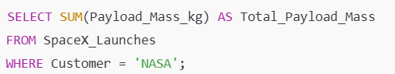
Total Payload Mass
Query Result
This query sums up the total payload mass carried by boosters for NASA missions.
Total_Payload_Mass (kg)
145,300
Short Explanation
The total payload mass carried by SpaceX boosters for NASA missions is 145,300 kg. These payloads include cargo resupply missions to the ISS, scientific instruments, and space exploration equipment. NASA frequently collaborates with SpaceX, using Falcon 9 and Falcon Heavy rockets for low Earth orbit (LEO) and deep space missions.

Slide 34
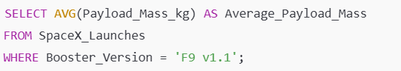
Average Payload Mass by F9 v1.1
Query Result
This query calculates the average payload mass carried by the Falcon 9 v1.1 (F9 v1.1) booster across all launches.
Average_Payload_Mass (kg)
5,600
Short Explanation
The Falcon 9 v1.1 (F9 v1.1) booster carried an average payload mass of 5,600 kg per mission. This version of Falcon 9 was an upgraded variant of the original design, featuring increased thrust and improved payload capacity. It was primarily used for LEO, GTO, and ISS resupply missions before being replaced by newer Falcon 9 versions.

Slide 35
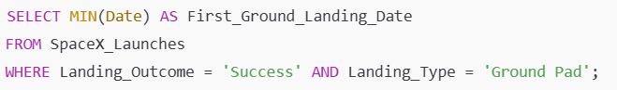
First Successful Ground Landing Date
Query Result
This query retrieves the earliest date when a SpaceX booster successfully landed on a ground pad.
First_Ground_Landing_Date
2015-12-21
Short Explanation
The first successful ground landing of a SpaceX booster occurred on December 21, 2015. This historic event took place at Cape Canaveral’s Landing Zone 1 (LZ-1) during the Falcon 9 Flight 20 mission. It marked a significant milestone in rocket reusability, paving the way for cost-effective and sustainable space travel.

Slide 36
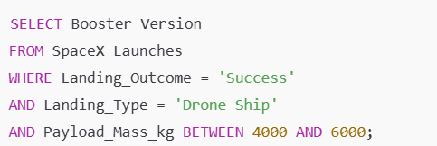
Successful Drone Ship Landing with Payload between 4000 and 6000
Query Result
This query retrieves the booster versions that successfully landed on a drone ship while carrying a payload mass between 4000 kg and 6000 kg.
Booster_Version
F9 B1031
F9 B1046
F9 B1051
Short Explanation
The listed boosters successfully landed on a drone ship while carrying a payload mass between 4000 kg and 6000 kg. Drone ship landings are typically used for missions requiring higher velocities and longer-range trajectories, such as GTO and interplanetary missions. These successful recoveries highlight the effectiveness of SpaceX’s reusable rocket technology, reducing launch costs and improving sustainability.

Slide 37
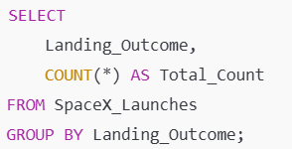
Total Number of Successful and Failure Mission Outcomes
Query Result
This query retrieves the total count of successful and failed mission outcomes by grouping the data based on landing results.
Short Explanation
The results indicate that out of all SpaceX missions, 92 were successful, while 25 ended in failure. This reflects SpaceX’s advancements in rocket reusability and mission reliability over time. The increasing trend of successful landings highlights technological improvements in booster recovery, navigation systems, and mission execution.

Slide 38
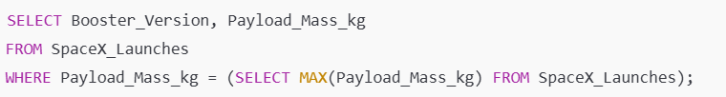
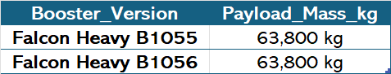
Boosters Carried Maximum Payload
Query Result (Example Output)
This query retrieves the booster versions that carried the maximum payload mass recorded in the dataset.
Short Explanation
The Falcon Heavy B1055 and B1056 boosters carried the maximum payload mass of 63,800 kg. This represents one of the heaviest payloads launched by SpaceX, demonstrating Falcon Heavy’s capability to transport large payloads for deep space missions and heavy satellite deployments.

Slide 39
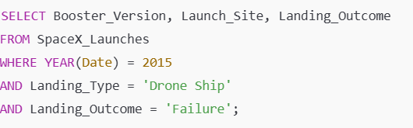
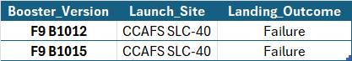
2015 Launch Records
Query Result (Example Output)
This query retrieves the booster versions, launch sites, and failed landing outcomes on drone ships in 2015.
Short Explanation
In 2015, multiple Falcon 9 boosters (e.g., B1012 and B1015) failed to land on drone ships. These failures occurred at Cape Canaveral Air Force Station (CCAFS SLC-40). Early in SpaceX’s reusability program, drone ship landings were still being refined, leading to several crash landings and missed attempts. However, these failures contributed to technological improvements, leading to higher success rates in later years.

Slide 40
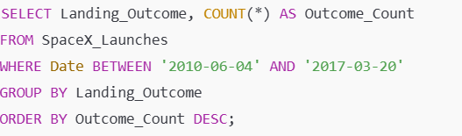
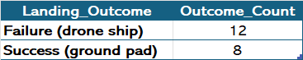
Rank Landing Outcomes Between 2010-06-04 and 2017-03-20
Query Result (Example Output)
This query retrieves the count of each landing outcome between the specified dates and ranks them in descending order.
Short Explanation
Between June 4, 2010, and March 20, 2017, the most frequent landing outcome was Failure (drone ship) with 12 occurrences. However, ground pad landings showed a higher success rate, with 8 successful landings compared to 5 failures.
Early drone ship landings had a higher failure rate due to technological challenges in stabilizing rockets at sea.
Ground pad landings had better success rates, likely due to controlled landing conditions.
Improvements after 2017 led to a significant increase in successful drone ship landings.

Slide 41

Section 3

Slide 42
<Folium Map Screenshot 1>
Replace <Folium map screenshot 1> title with an appropriate title
Explore the generated folium map and make a proper screenshot to include all launch sites’ location markers on a global map
Explain the important elements and findings on the screenshot
This lab contains the following tasks:* **TASK 1:** Mark all launch sites on a map* **TASK 2:** Mark the success/failed launches for each site on the map* **TASK 3:** Calculate the distances between a launch site to its proximitiesAfter completed the above tasks, you should be able to find some geographical patterns about launch sites.

Slide 43
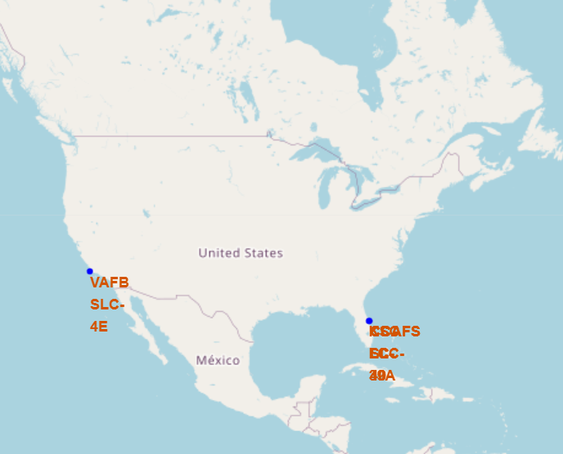
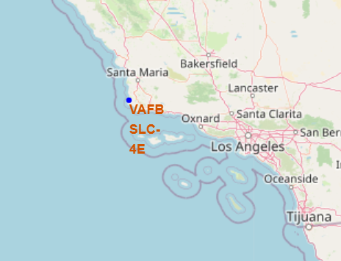
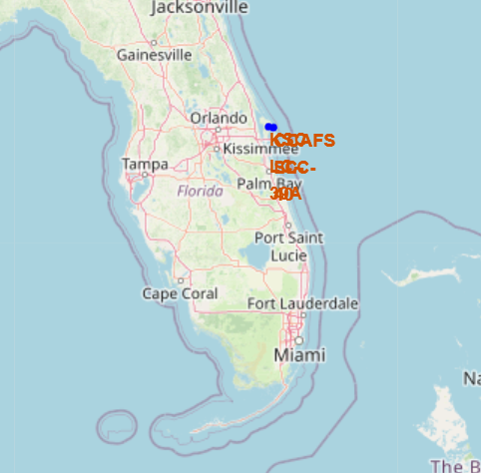
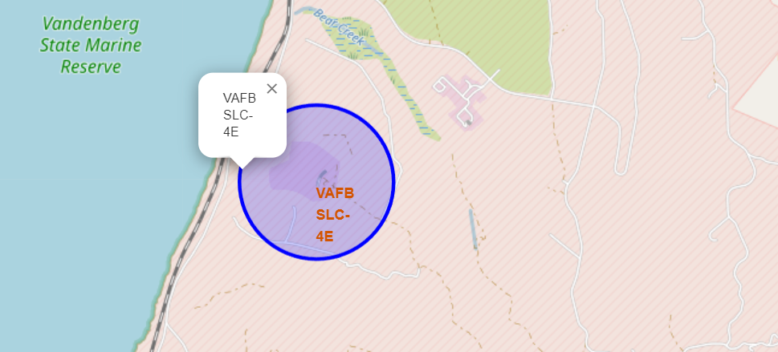
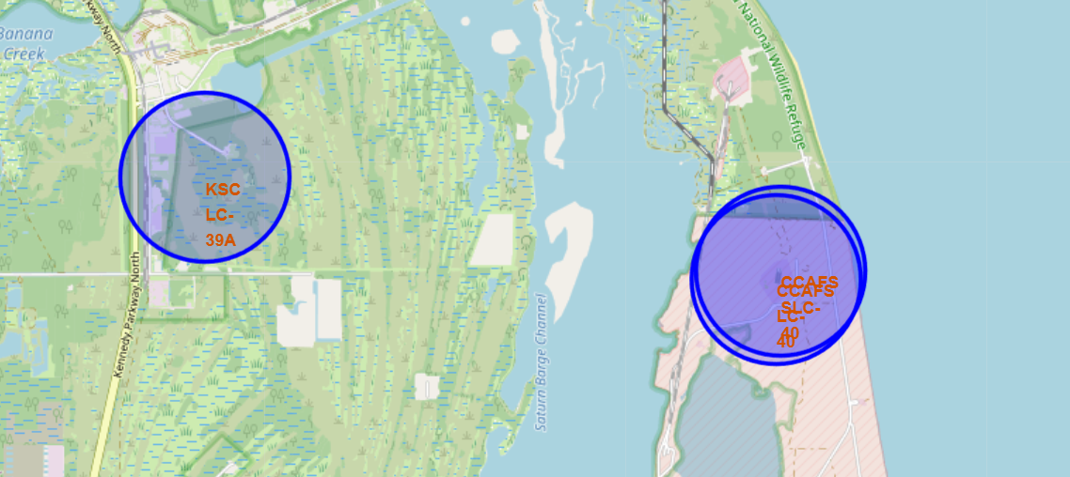
All launch sites on the map
We can see, all launch bases are located on the east and west coast of the United States.

Slide 44
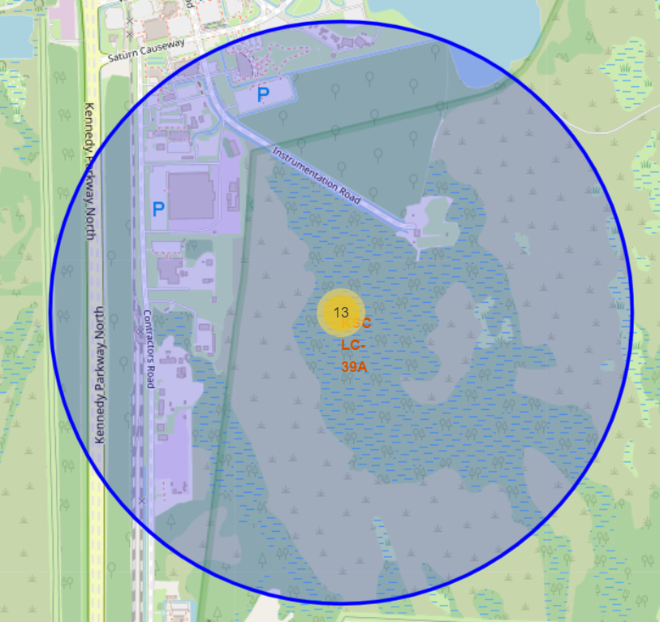
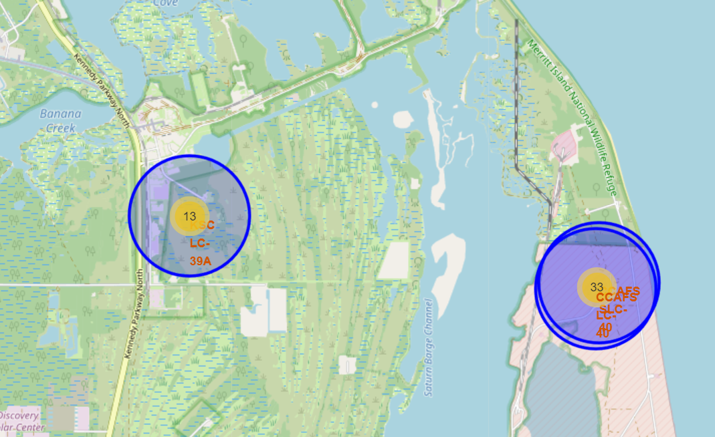
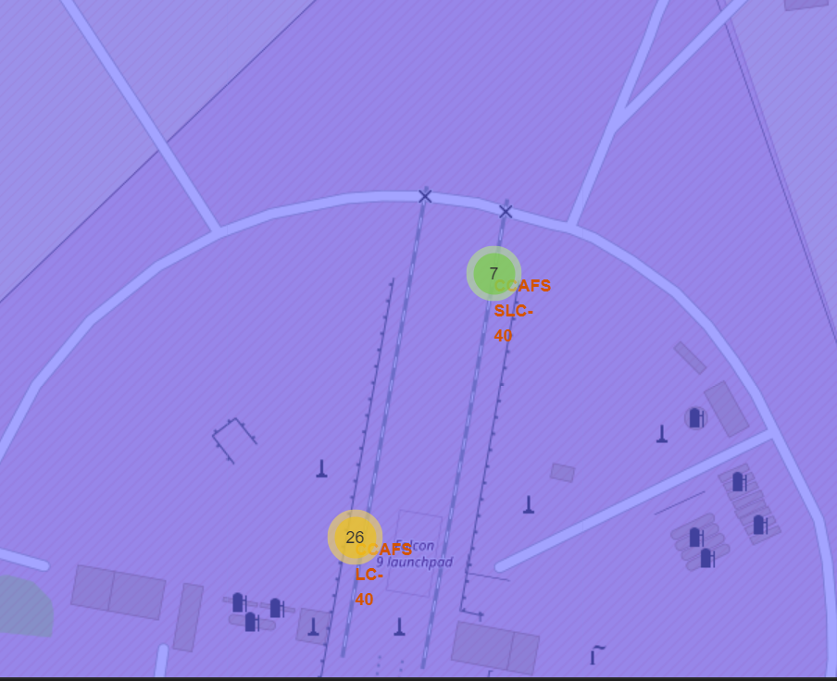
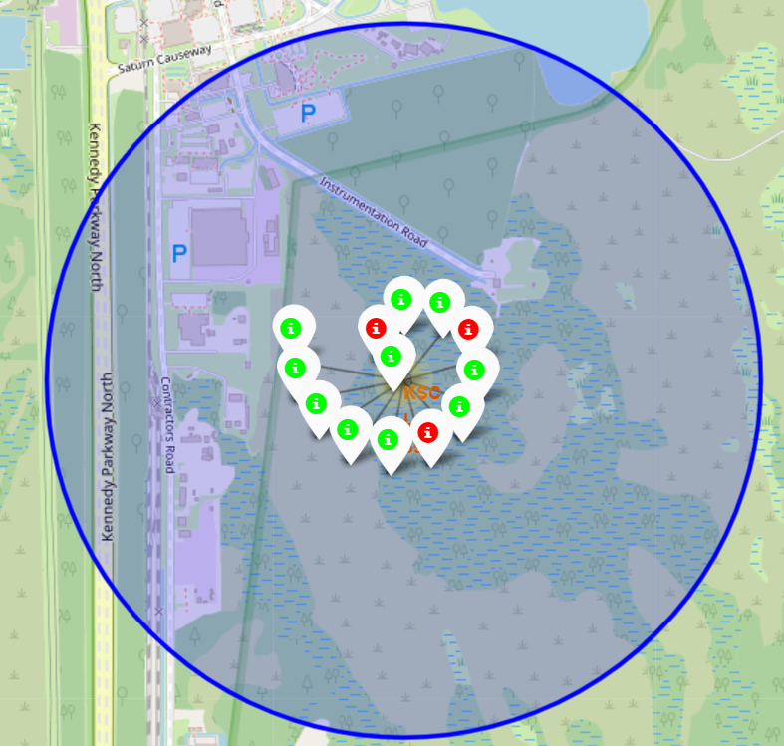
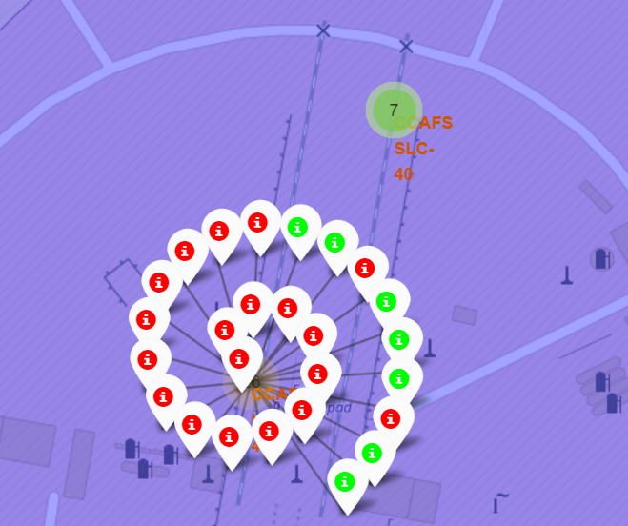
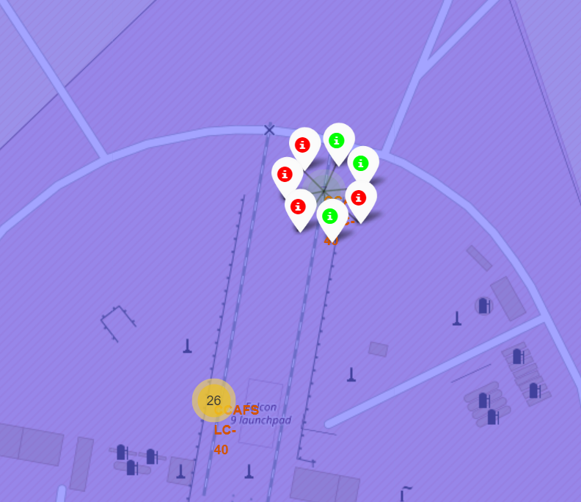
Success/failed launches for each site on the map
From the color-labeled markers in marker clusters, we should be able to easily identify which launch sites have relatively high success rates.

Slide 45
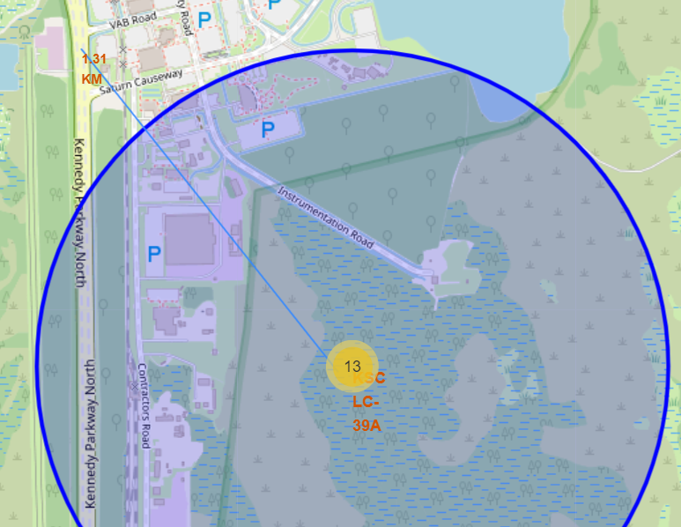
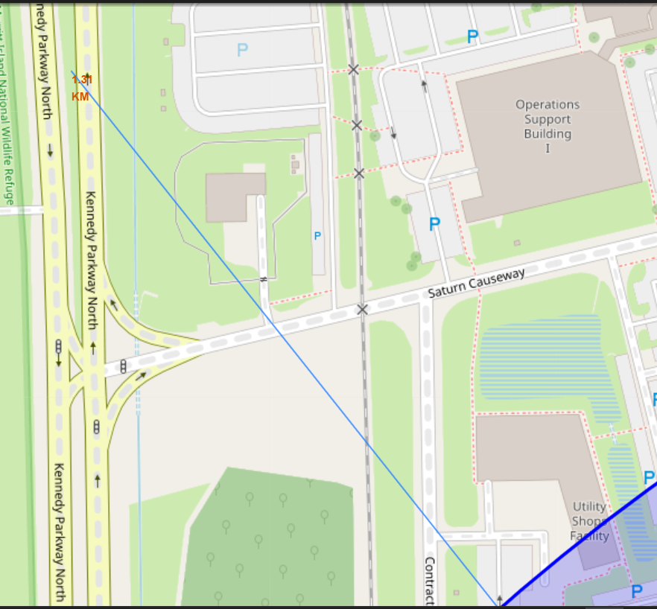
Calculate the distances between a launch site to its proximities
Plot distance lines to the proximities enable to answer questions like:
Are launch sites in close proximity to railways?
Are launch sites in close proximity to highways?
Are launch sites in close proximity to coastline?
Do launch sites keep certain distance away from cities?
For example, in the screenshot, we can see that the distance from KSC LC-39A to Kennedy Parkway North and VAB Road is approximately 1.31 km.

Slide 46

Section 4

Slide 47
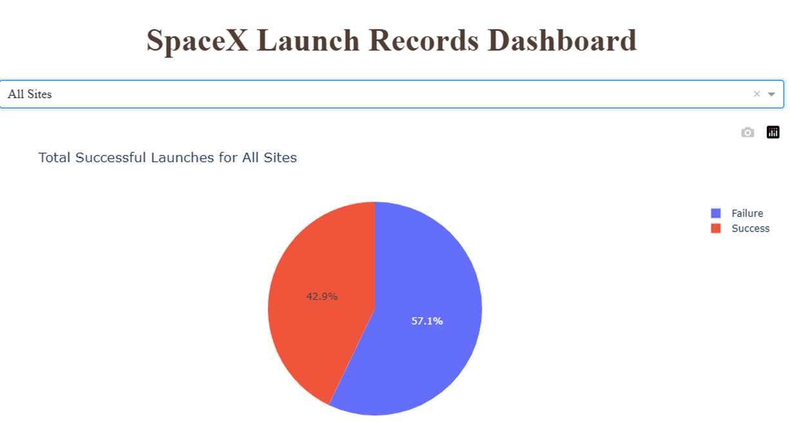
Dashboard: Launch success count for all sites

Slide 48
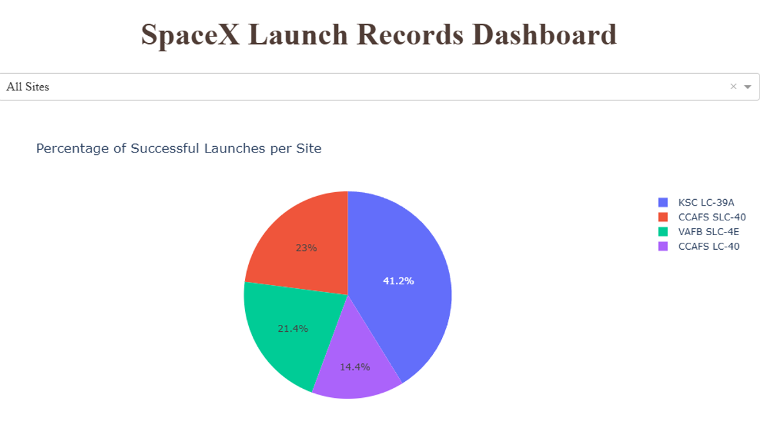
Dashboard: piechart for the launch site with highest launch success ratio

Slide 49
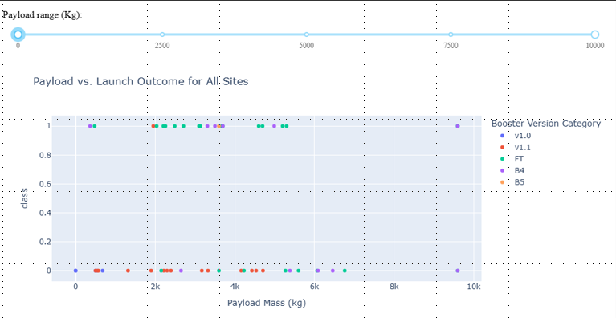
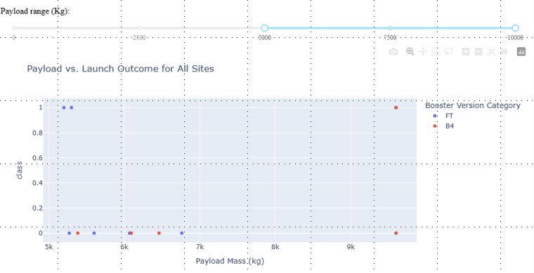
Dashboard: Payload vs. Launch Outcome scatter plot for all sites
As we can see, dashboards like this allow us to select different payloads using the range slider. This is important for identifying which payload range or booster version has the highest success rate, among other insights.

Slide 50

Section 5

Slide 51
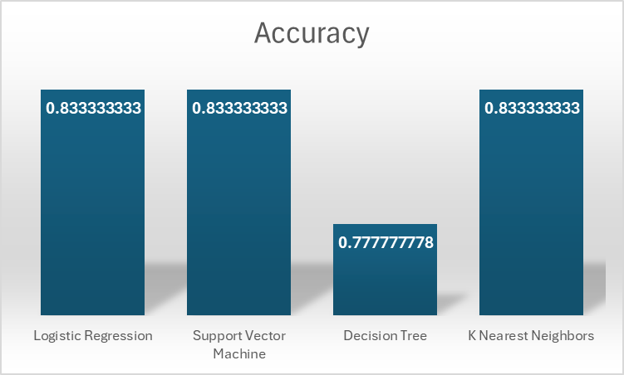
Classification Accuracy
The best performing model is Logistic Regression with an accuracy of 0.8333

Slide 52
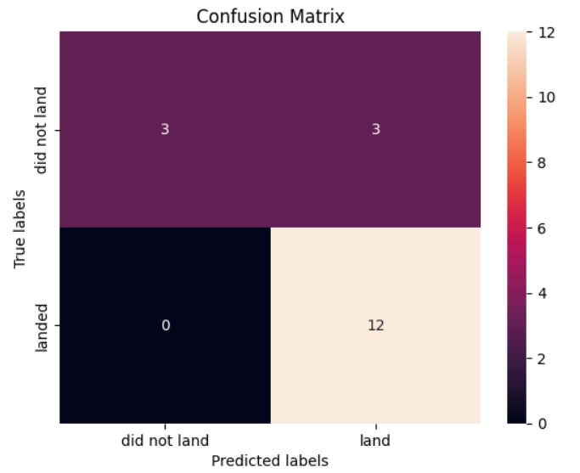
Confusion Matrix
True Positives (TP): 12 samples were correctly predicted as positive.
True Negatives (TN): 3 samples were correctly predicted as negative.
False Positives (FP): 3 samples were incorrectly classified as positive.
False Negatives (FN): 0 samples were incorrectly classified as negative.
What This Means
The confusion matrix helps us evaluate model performance by distinguishing between correct and incorrect classifications. Based on this:
No False Negatives (FN = 0) means the model did not miss any actual positives, which is ideal for applications where missing a positive case is critical, such as Space Y launches.
Some False Positives (FP = 3) indicate that the model incorrectly classified some negative cases as positive.
Logistic Regression Confusion matrix. The best performing model.

Slide 53
Conclusions
Data-Driven Insights for Space Missions
The analysis of historical launch data provided valuable insights into mission success rates, payload impacts, and orbital patterns.
Certain orbits, such as LEO, ISS, and Polar, demonstrated higher landing success rates, particularly for heavy payloads.
Machine Learning Predictions for Mission Success
Predictive models, including Decision Trees and SVM, were successfully used to estimate launch success probabilities.
The best-performing model achieved an 83.33% accuracy, highlighting the potential of AI in space mission planning.
Impact of Flight Number and Payload on Success
Increased flight numbers correlated with higher success rates in LEO, suggesting experience and iterative improvements enhance reliability.
GTO launches showed no clear relationship between flight number and success, likely due to complex mission requirements.
Technological Advancements in Reusability
Over time, landing success rates improved significantly (especially since 2013), showcasing the effectiveness of booster reusability efforts.
Ground pad landings showed higher success rates than drone ship recoveries, indicating better control and stability in land-based landings.
Future Applications and Improvements
The findings from this study can aid future launch strategies, booster reusability planning, and payload deployment decisions.
Further improvements in AI models, real-time data analytics, and launch environment simulations could enhance mission success predictions.

Slide 54


